Slide 1

Learned 3D Semantic Segmentation using Point Clouds
Michael Seeber
23.10.2018
Advisors: Ian Cherabier, Audrey Richard, Martin Oswald

Slide 2
Table of content
Introduction and related work
Reconstruction
Semantic segmentation
Motivation
Method
PointNet
Learned Priors
Pipeline
Experiments and results
Recap and future work
Notes:
1 min

Slide 3
Introduction & Related work
Notes:
8 min

Slide 4
3D Reconstruction
= Process of capturing the shape and appearance of real objects
Multi-view reconstruction
Rely on photo-consistency metrics
Semantic information as additional metric to cope with reflection, image noise etc.…
Jointly optimize geometry & semantics → hand-crafted regularizers
Dense semantic 3d reconstruction [1]
Deep learning allowed to learn regularizers from data → lot of parameters
Express gradients though more general matrix → fast & powerful
Learning Priors for 3D Reconstruction [2] - our baseline
[1] Christian Haene, Christopher Zach, Andrea Cohen, and Marc Pollefeys. Dense semantic 3d reconstruction.
[2] Ian Cherabier, Johannes L Schönberger, Martin R Oswald, Marc Pollefeys, and Andreas Geiger. Learning priors for semantic 3d reconstruction.
Notes:
5min

Slide 5
Semantic segmentation
= partition a captured scene into predefined semantic classes
2D:
Classical feature extraction: thresholding, clustering, region extraction
Deep learning: GoogLeNet, AlexNet [1] etc...
3D:
Volumetric CNNs→ only feasible for small scenes
Multi-view CNNs: recognize semantics through 2D views
Point clouds: efficient and natural representation, but can’t use classical CNNs
→ PointNet [2]
[1] Alex Krizhevsky, Ilya Sutskever, and Geoffrey E Hinton. Imagenet classification with deep convolutional neural networks.
[2] Charles R Qi, Hao Su, Kaichun Mo, and Leonidas J Guibas. Pointnet: Deep learning on point sets for 3d classification and segmentation.
Notes:
8min

Slide 6
Motivation
Problem: Current 3D reconstruction methods rely on 2D image segmentation for
obtaining semantic information.
Solution: Create a pipeline that directly does semantic segmentation on point clouds and encodes the information in a meaningful datacost for 3D reconstruction.
Notes:
9 min

Slide 7
Method
Notes:
11 min

Slide 8
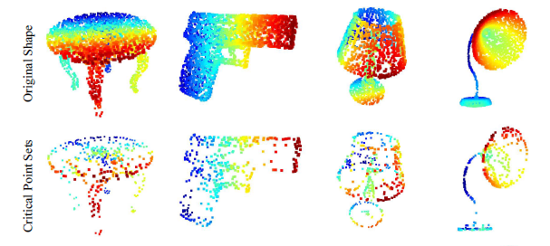
PointNet
Capable of reasoning about 3D geometries directly from point clouds.
Learns to summarize a shape by a spare set of key points
[PointNet, Qi et al., 2017]

Slide 9
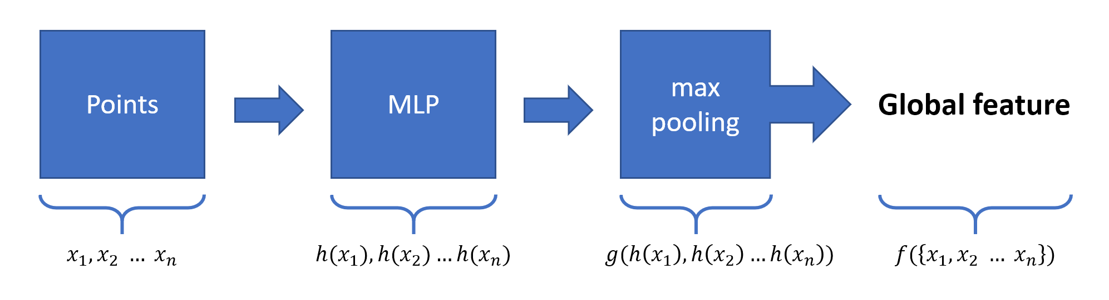
PointNet Theory
symmetric
$$f\left(x_{1}, …, x_{n}\right) ≈g(h\left(x_{1}\right), …, h\left(x_{n}\right))$$
The network learns criterias for selecting interesting and informative points and also encodes the reason for choosing them.

Slide 10
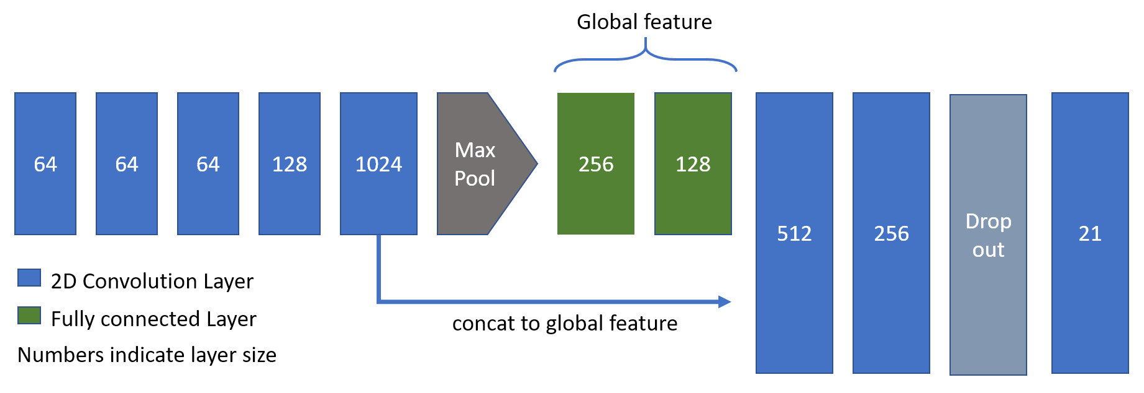
Segmentation network model

Slide 11
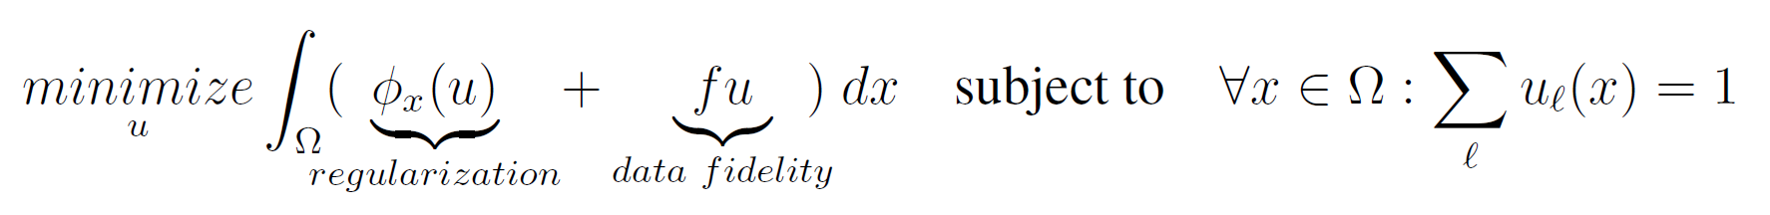
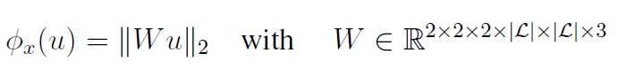
Learned Priors - Theory

Slide 12
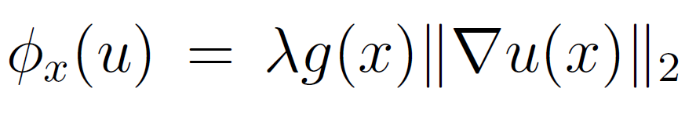
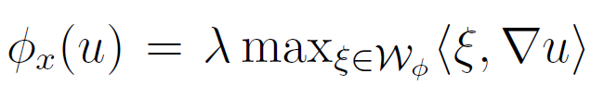


Learned Priors - Theory
$$∇u$$
$$∇u$$
Total variation:
Wulff-Shape:

Slide 13
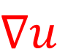
Learned Priors - Theory
$$∇u$$
$$∇u$$
Total variation:
Wulff-Shape:

Slide 14
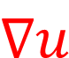
Learned Priors - Theory
$$∇u$$
Wulff-Shape:

Slide 15
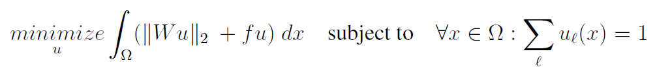
Learned Priors - Theory
$$∇u$$
Wulff-Shape:

Slide 16
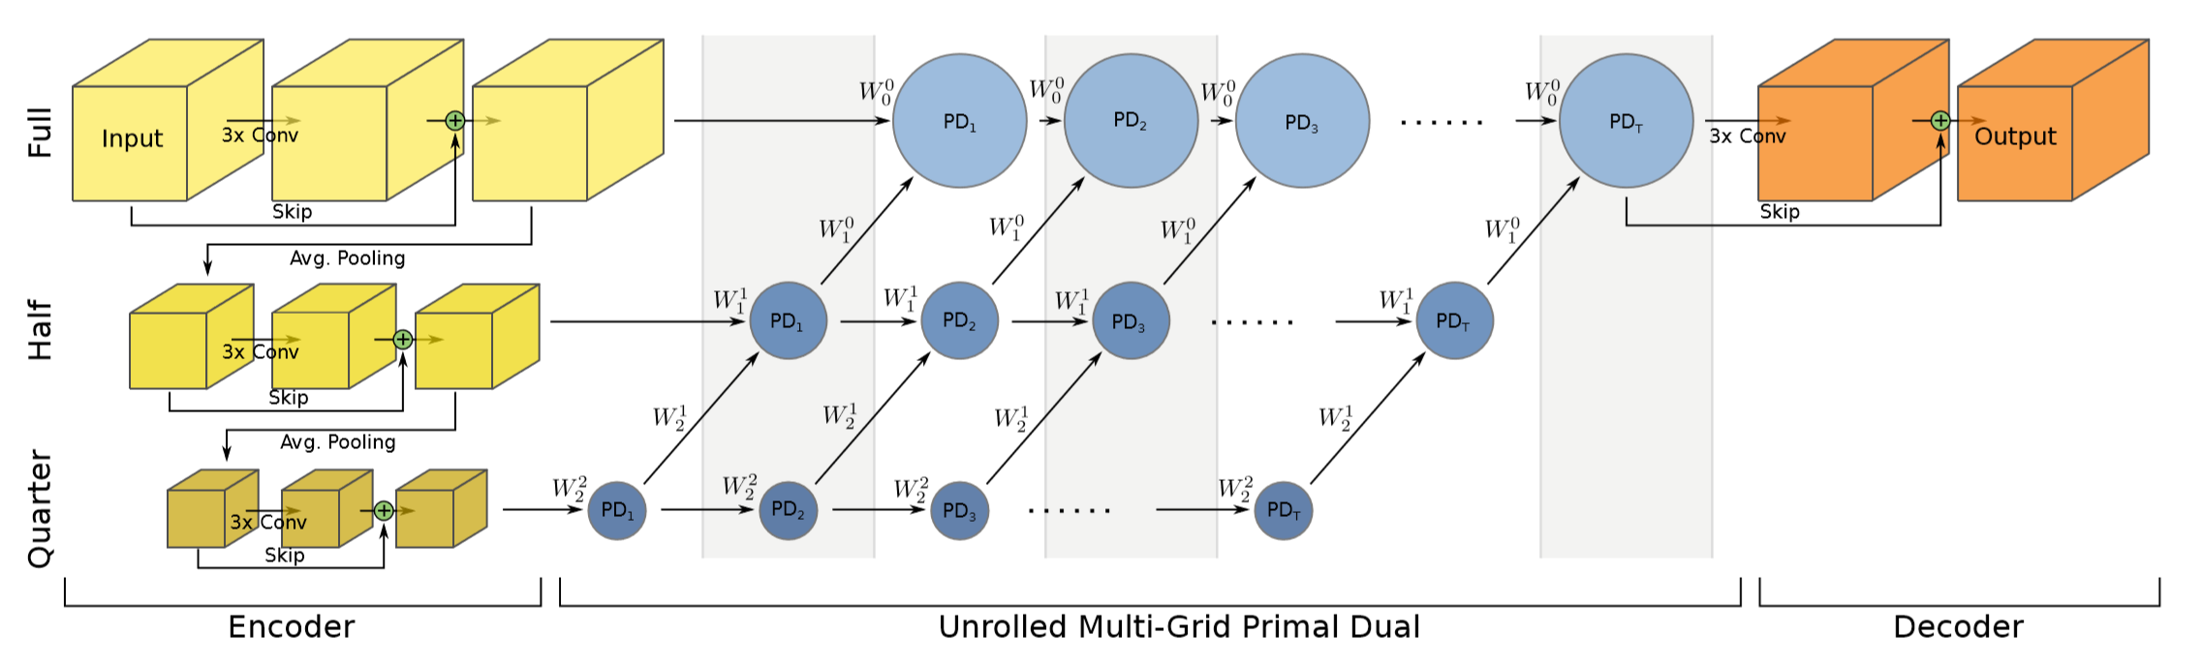
Model
[Learning priors for semantic 3d reconstruction, Cherabier et al., 2018]
Notes:
18

Slide 17
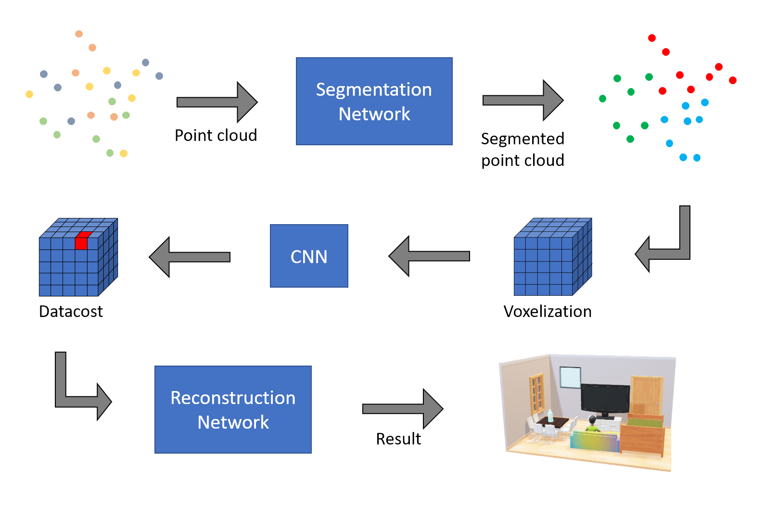
Pipeline

Slide 18
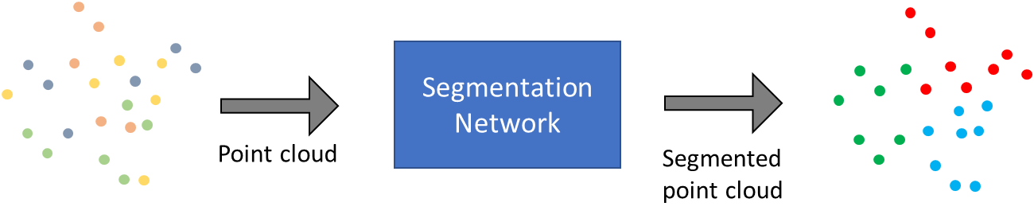
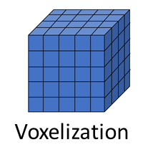
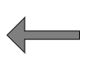

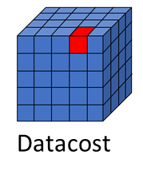
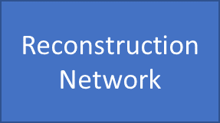
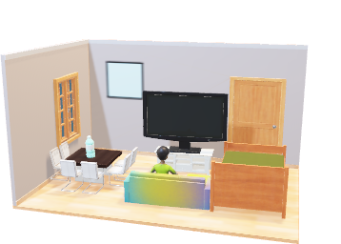
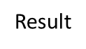
Voxelization

Slide 19
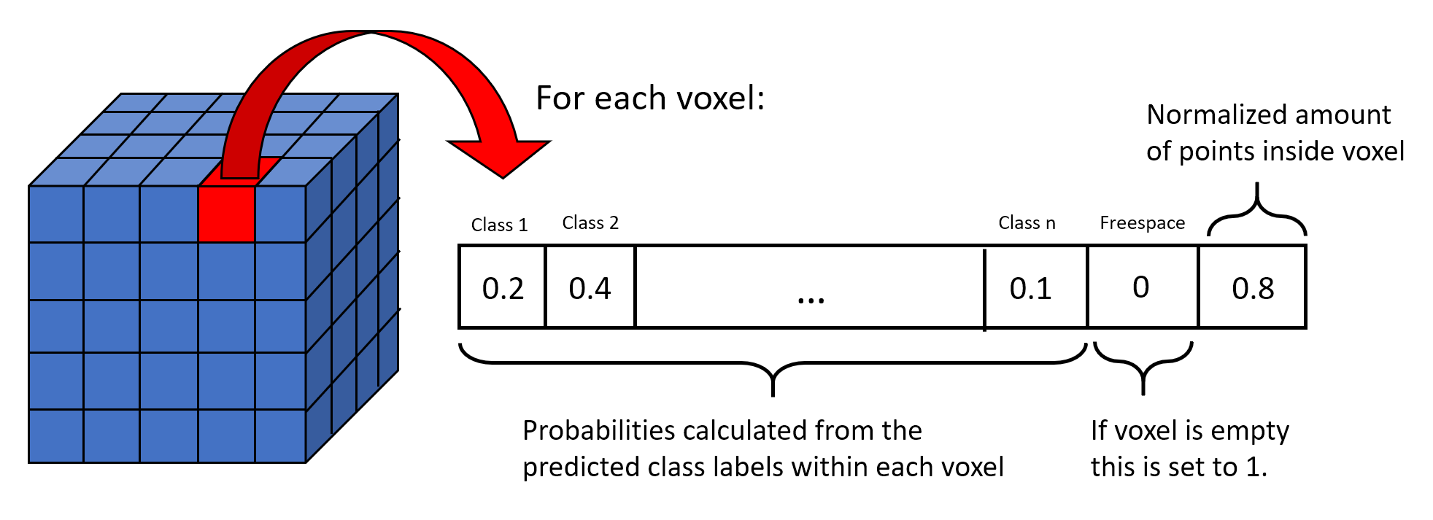
Voxelization

Slide 20
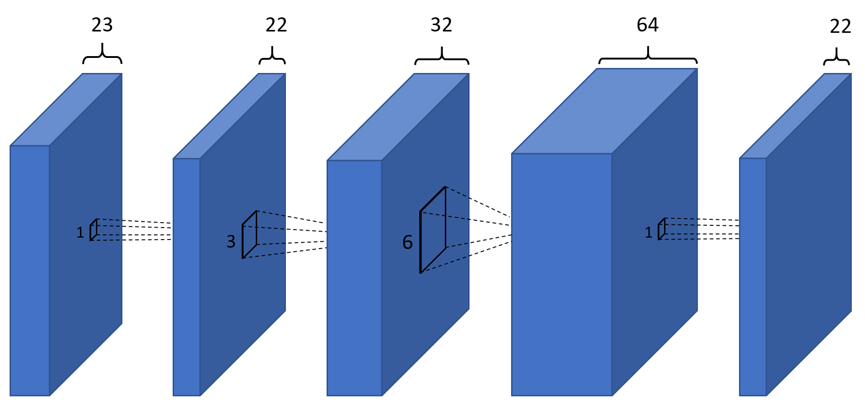
CNN
Compress the 23 channels into 22.
Combine semantic information from nearby voxels into meaningful datacost.

Slide 21
CNN
Compress the 23 channels into 22.
Combine semantic information from nearby voxels into meaningful datacost.

Slide 22
Pipeline

Slide 23
Experiments & Results

Slide 24
ScanNet Dataset
Provides annotated scans of various real-world indoor environments
Set | Categories | # training scenes | # testing scenes
Set 0 | Apartments | 33 | 7
Set 1 | … + Living room/Lounge | 212 | 52
Set 2 | … + Bedroom/Hotel | 430 | 107
Set 3 | … + Office | 569 | 141
full | all | 1211 | 302

Slide 25
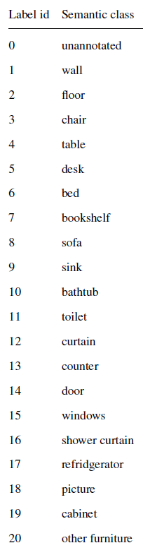
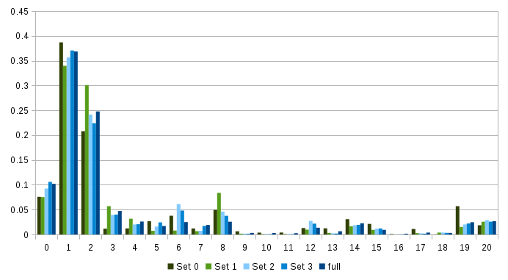
Label distribution for train splits
→ weighted cross entropy loss
Label id

Slide 26
Early segmentation results
 | Accuracy | Weighted class accuracy | Average class accuracy
Set 0 | 50.7% | 45.9% | 14.9%
Set 1 | 59.7% | 45.3% | 11.1%
Set 2 | 56.0% | 45.8% | 11.5%
Set 3 | 56.5% | 47.9% | 11.1%
full | 53.0% | 42.9% | 9.9%

Slide 27
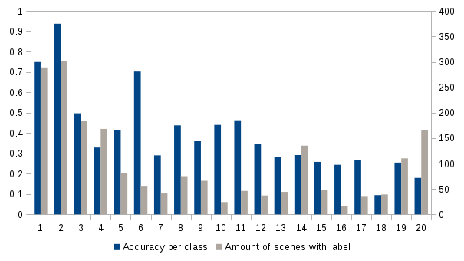
Semantic segmentation results
 | Accuracy | Weighted class accuracy | Average class accuracy
Random rotations | 53.0% | 42.9% | 9.9%
Limited rotations | 71.4% | 58.8% | 16.1%
Label ids

Slide 28
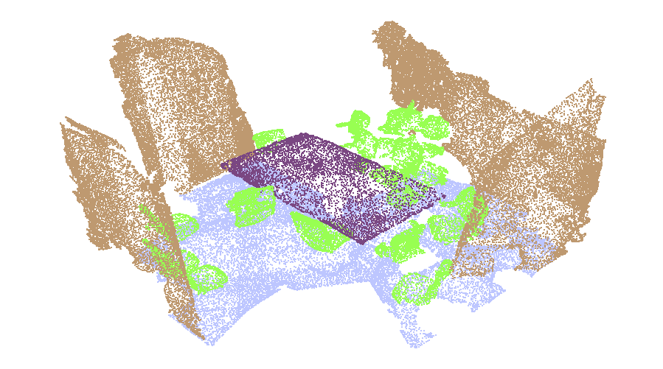
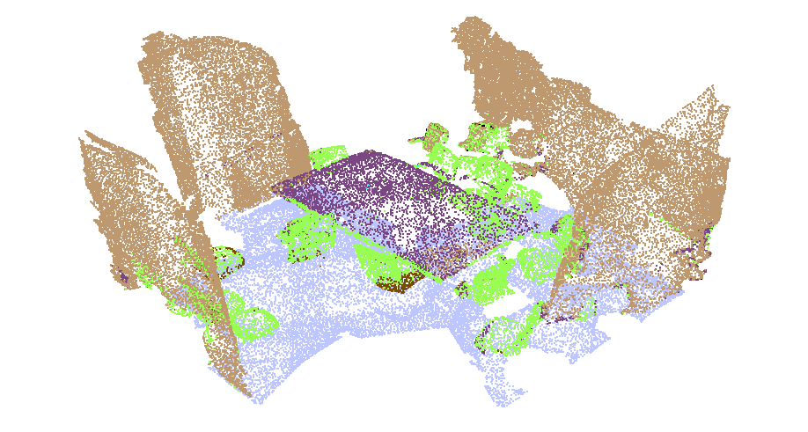
Segmentation of meeting room scene
Groundtruth
Prediction

Slide 29
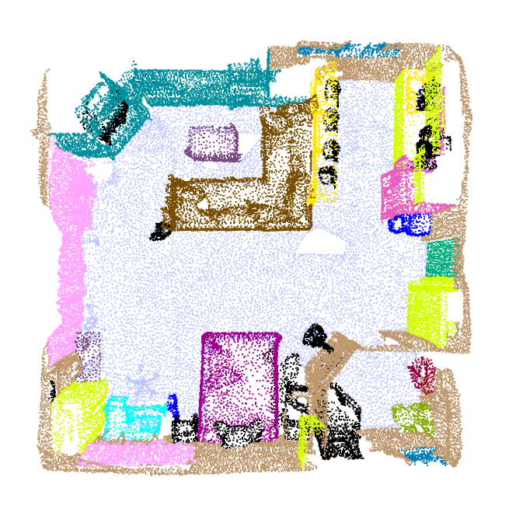
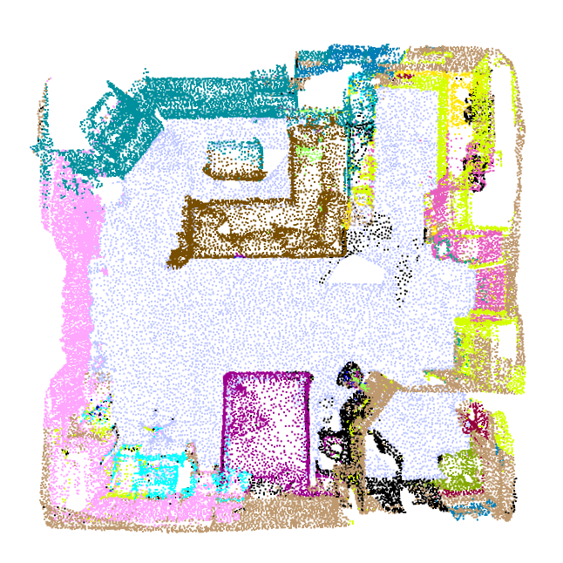
Segmentation of apartment scene
Groundtruth
Prediction

Slide 30
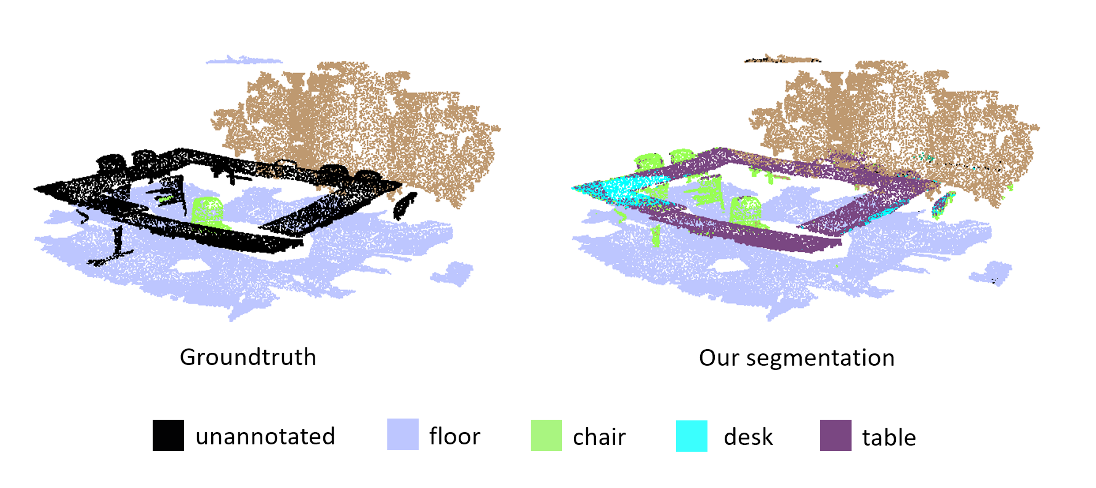
Interesting segmentation example

Slide 31
Reconstruction Results
Accuracy | Freespace accuracy | Occupied accuracy | Semantic accuracy
67.1% | 87.7% | 54.8% | 38.7%

Slide 32
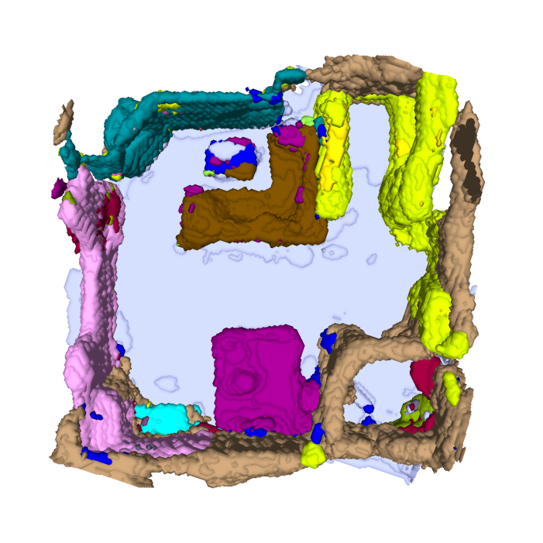
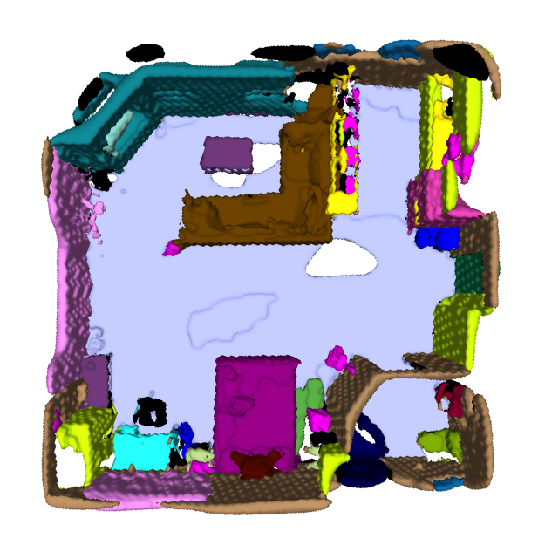
Reconstruction of apartment scene

Slide 33
Reconstruction of apartment scene

Slide 34
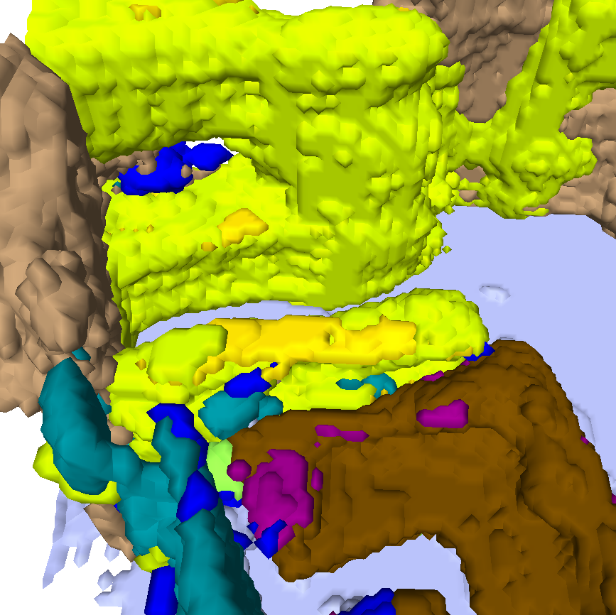
Reconstruction of apartment scene

Slide 35
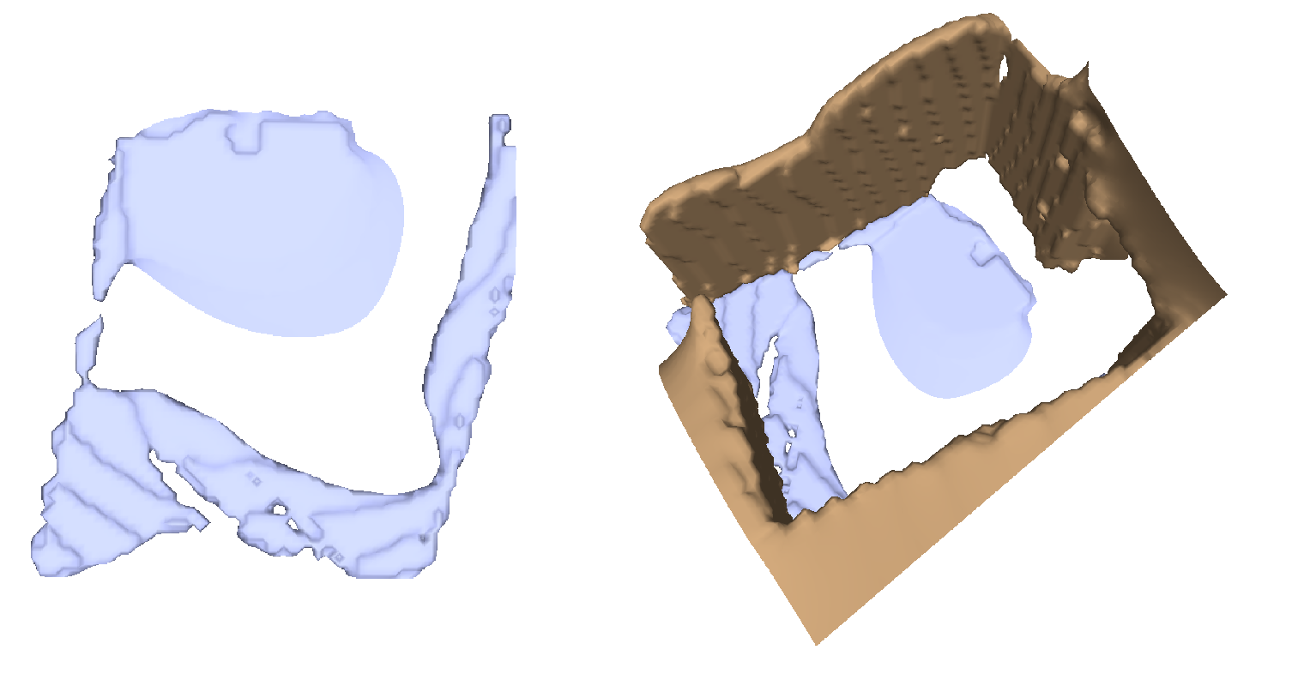
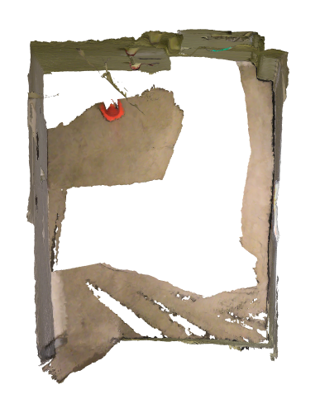
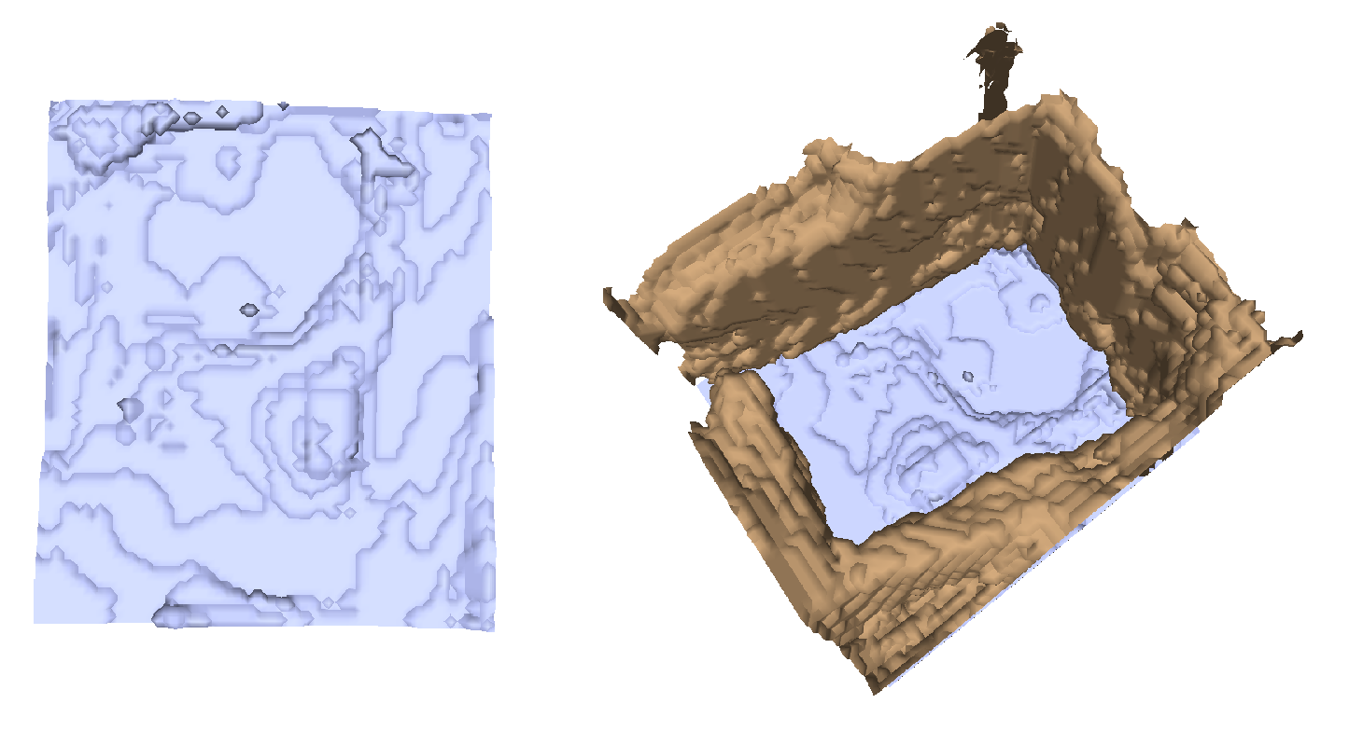
Floor reconstruction
Groundtruth:
Prediction:
Original scan

Slide 36
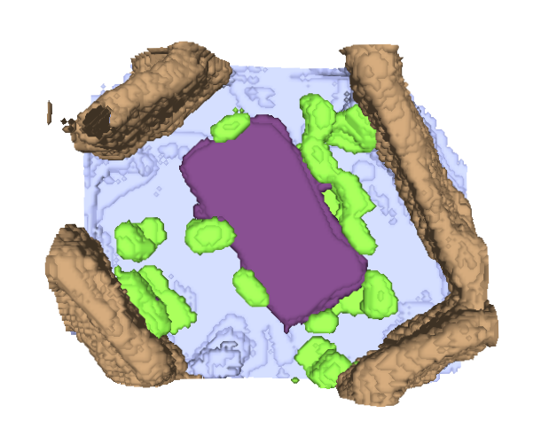
Reconstruction of meeting room scene

Slide 37
Reconstruction of meeting room scene

Slide 38
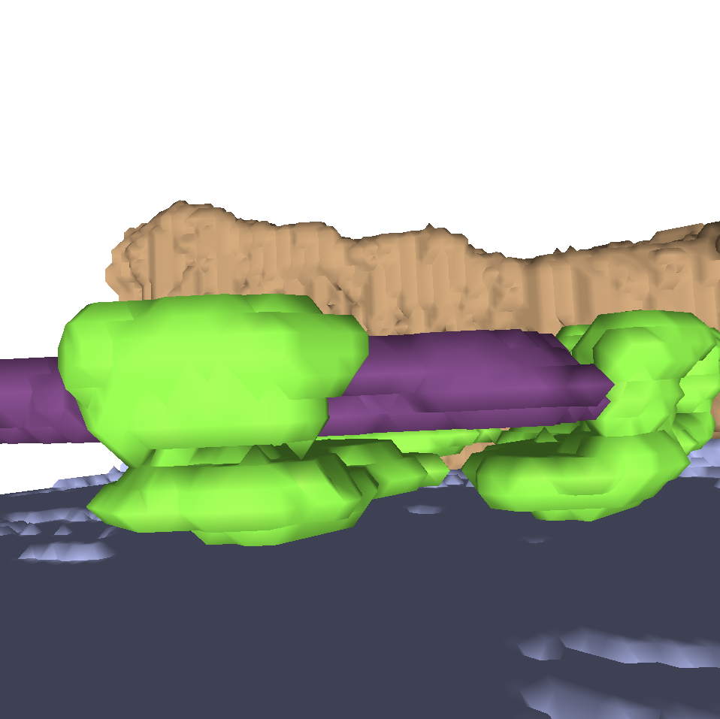
Reconstruction of meeting room scene

Slide 39
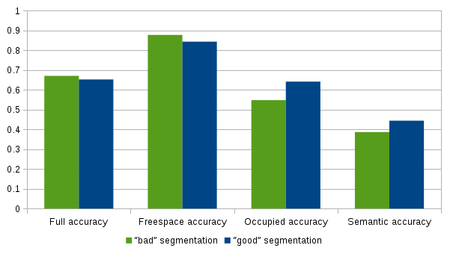
Impact of segmentation accuracy
 | Accuracy | Weighted class accuracy | Average class accuracy
“Bad” segmentation | 53.0% | 42.9% | 9.9%
“Good” segmentation | 71.4% | 58.8% | 16.1%

Slide 40
Ability of best model to handle bad segmentations
 | Accuracy | Weighted class accuracy | Average class accuracy
“Bad” segmentation | 53.0% | 42.9% | 9.9%
“Good” segmentation | 71.4% | 58.8% | 16.1%

Slide 41
Recap & future work
We implemented a pipeline that segments point clouds into semantic classes and encodes the information into a meaningful datacost, from which the reconstruction network was able to produce satisfying results.
Possible future steps:
Improve segmentation → although impact will be limited
Use fewer more general semantic classes that share similar shape priors
More engineering on the intermediate CNN → compensate bad segmentations
Long-term goal:
Not voxelize the scene and directly do the reconstruction from point clouds.
Notes:
2 min

Slide 42
Thank you!
Questions?

Slide 43
Backup
Slides

Slide 44
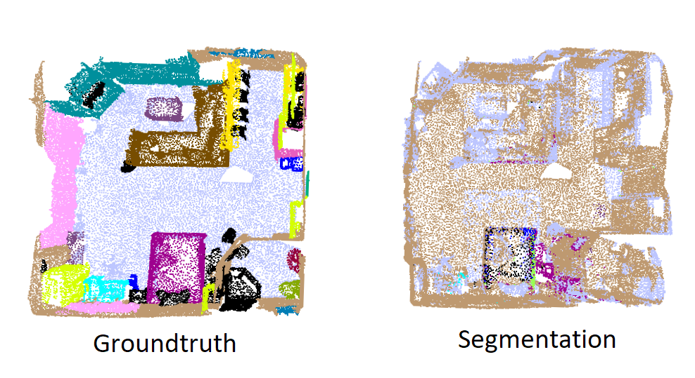
Vanilla PointNet on ScanNet dataset

Slide 45
Vanilla PointNet on ScanNet dataset

Slide 46
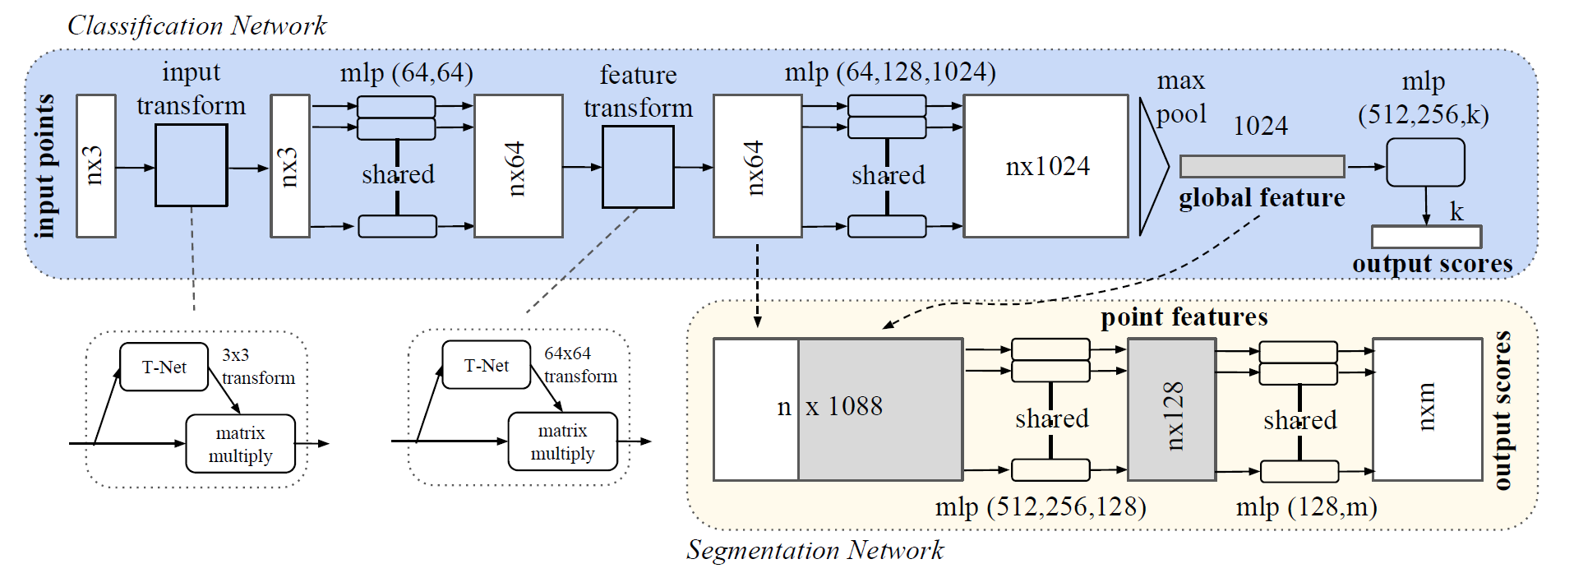
PointNet architecture
[PointNet, Qi et al., 2017]

Slide 47
Important implementation differences
No T-Net
Weighted loss
Limiting the random rotations
Only 6-dimensional input vector (XYZRGB)
21 labels instead of 13 labels
Bigger block size
Notes:
14

Slide 48
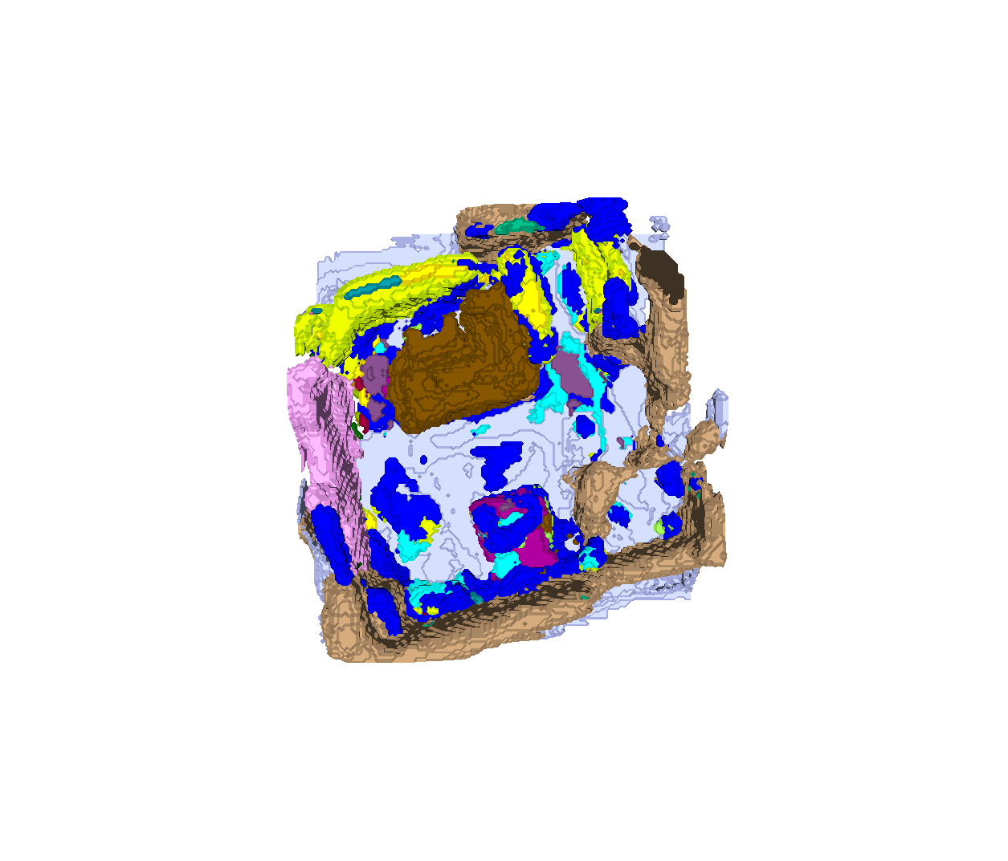
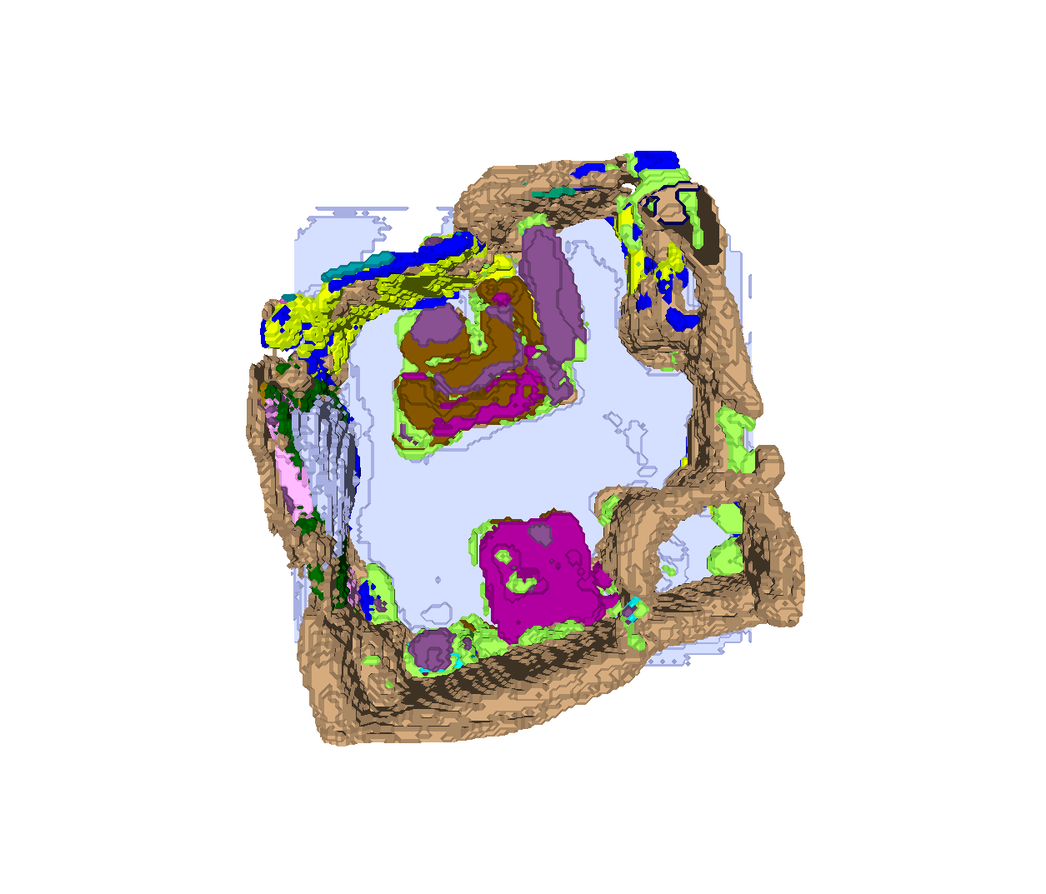
Reconstruction
Bad segmentation feed into model trained with good segmentations.
Bad segmentation feed into model trained with bad segmentations.

